Slide 1
Angular Component

Slide 2
Introduction
A component is anything visible to end user and can be reused many times within an app
It controls a patch of screen called a view
Component can in tern can have multiple sub-components.
All components will have a beginning called root-component. From there components will further have tree structure in a modular fashion.

Slide 3
Elements of Component
Component
Data
HTML
(Template)
Logic

Slide 4
Benefits of Component
Modular: It makes the application more modular, in alignment with framework
Data encapsulation: Data access via methods
Re-usable: Makes the development more efficient

Slide 5
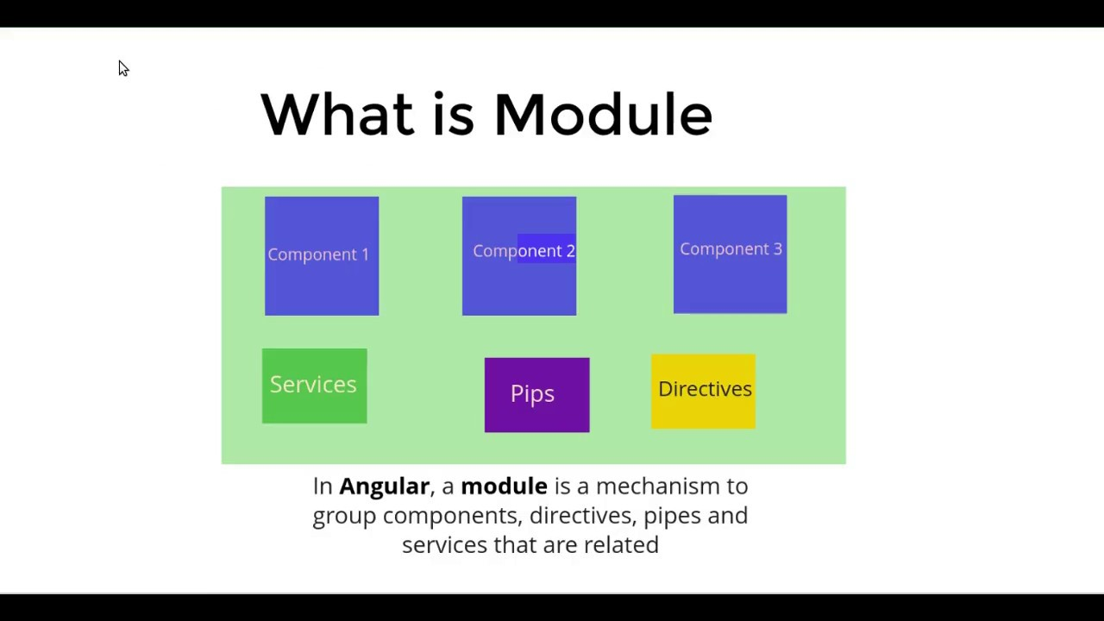
What is module?

Slide 6
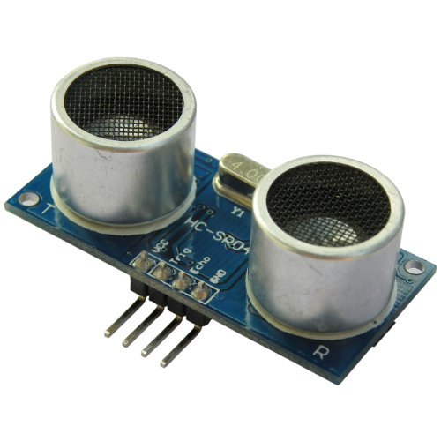
Module
Every Angular App has at least one module, called root module. Root module is conventionally named AppModule.
Most apps have more than one module(root module + individual feature module)

Slide 7
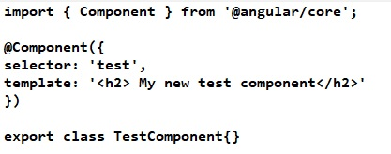
Creating a component
Step 1: Creating and Adding ypur component TS file
Open App folder of your project
Add a new file in the following format: <component_name>.component.ts (Ex test.component.ts)
Add the Following lines into your component file

Slide 8
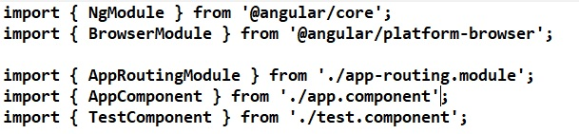
Creating a component
Step 2: Make your component as a part of the module (app.module.ts file) [ Note: Make your component available for Module by importing it into the module]

Slide 9
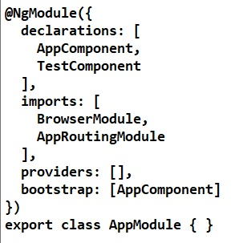
Creating a component
Step 2: Make your component as a part of the module (app.module.ts file)
Add your new component (ex: TestComponent) under the declarations of the module.
Please note the module contains more than components.

Slide 10
Creating a component
Step-3: Go-to app.component.html file and add your selector (ex: test into this file). You can add any HTML code here.
Also ensure, you delete previously existing HTML code ensure the file looks cleaner and easier to read
Step 4: Save all files and run your Angular App again (ng serve --open)

Slide 11
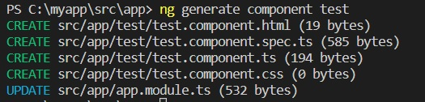
Creation Component-CLI
Sometimes it very difficult to create component manually.
Angular CLI offers much more reliable way to create a component. Try the following command , which will not only generate a component but also make appropriate entries.
ng generate component test

Slide 12
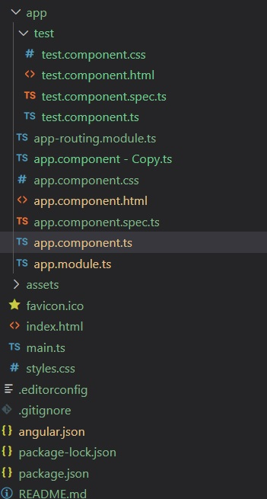
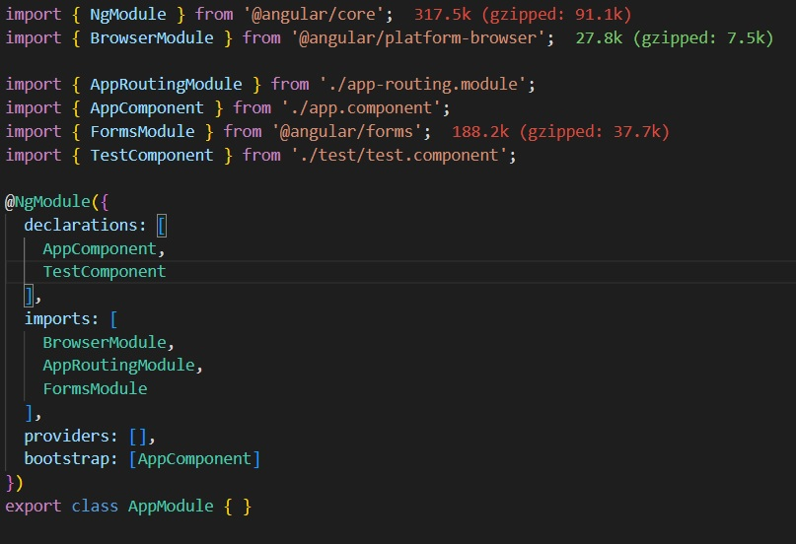
Creation Component-CLI

Slide 13
Creation Component-CLI
Now you may see in your newly generated component, you have three files(HTML/CSS/TS), the three important files to run a typical front end application.
Any changes you can make into the HTML file and include corresponding selector into app.component.html
By having multiple components means there are multiple pieces coming together and working in an app. This is just a beginning, so many things we can do on top this.

Slide 14
Communication among Components
Using URLs and routing
Using @input() and @output() decorators
Passing data through services using Observable.

Slide 15
Types of Communication
Component communication
Parent o child
Child to Parent
Between siblings

Slide 16
Communication among Components
1. Parent to Child

Slide 17
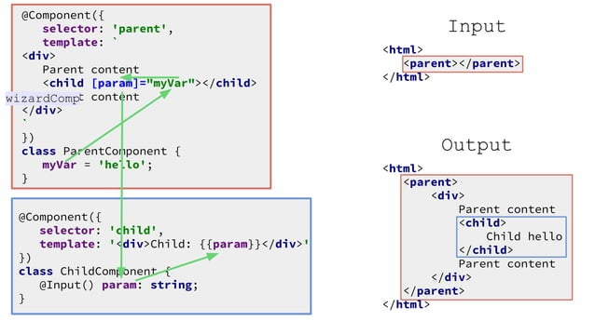
Communication among Components
1. Parent to Child

Slide 18
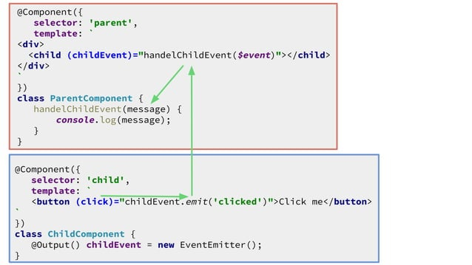
Communication among Components
2. Child to Parent

Slide 19
Communication among Components

Slide 20
Communication among Components

